Slide 1
Localizing Sounds

Slide 2
Localizing Sounds
When we perceive a sound, we often simultaneously perceive the location of that sound.
Even new born infants orient their eyes toward sound sources.
Interestingly, a given sound contains absolutely no physical property that designates its location.
So the ability to localize a sound must be caused entirely by neural events, since we can’t “pick-up” positional cues from the stimulus itself.

Slide 3
Localizing Sounds
Ideally, it would be adaptive for an organism to localize sounds in all three spatial dimensions.
For simplicity, we’ll begin omitting the depth dimension (i.e., the “z” -axis). We’ll return to that later.
Azimuth: Position along the horizontal plane (“x”-axis).
Elevation: Position along the vertical plane (“y”-axis).
Let’s see a diagram of these planes….

Slide 4
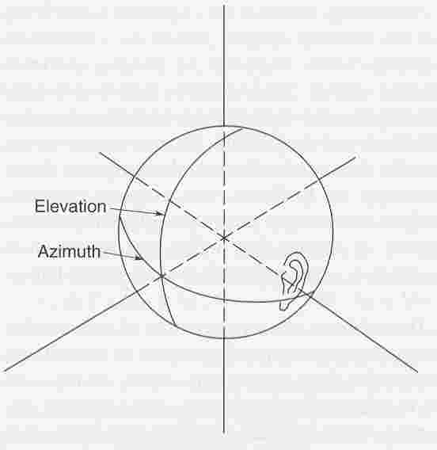
Localizing Sounds
Both azimuth and elevation are relative to head position
(or more precisely, “ear level”).

Slide 5
Localizing Sounds
So, psychophysicists describe locations by using two coordinates, one for azimuth and one for elevation.
The two coordinates seem to be specified to the listener by different neural events.
Let’s first consider the neural events that pertain to the azimuth (horizontal plane)…

Slide 6
Localizing Sounds
Interaural Intensity Difference (IID): The disparity between the amount of acoustic energy that reaches the left and right ears.
IIDs vary with the azimuth (i.e., horizontal position) of the source, and the frequency of the stimulus, as shown here…

Slide 7
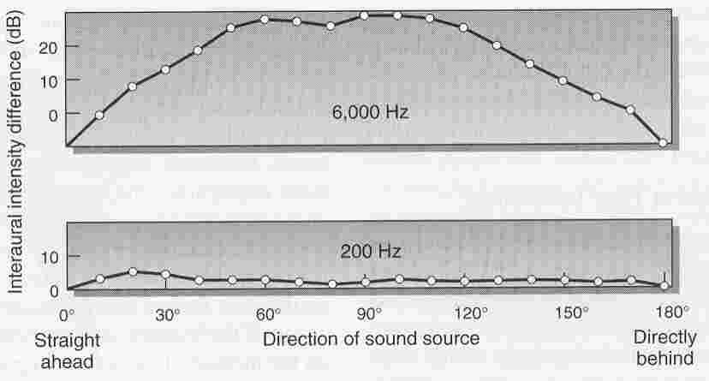
Localizing Sounds
For 6,000 Hz tone, the acoustic energy differs by 20 dB
in the two ears.

Slide 8
Localizing Sounds
For 6,000 Hz tone, the acoustic energy differs by 20 dB
in the two ears.
BUT, this is not true for the 200 Hz tone,
which produces no IIDs with azimuth.

Slide 9
Localizing Sounds
Interaural Time Difference (ITD): The disparity between the time-of-arrival at the left and right ears.
ITDs vary with the azimuth (i.e., horizontal position) of the source.

Slide 10
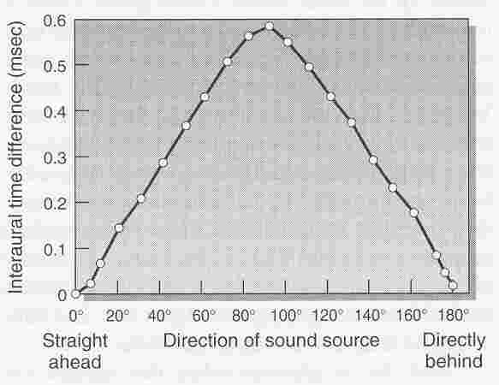
Localizing Sounds
ITDs are largest (0.6 msec) when the sound originates
from the left or right.

Slide 11
Localizing Sounds
The Duplex Theory Of Sound Localization: ITDs are used to localize low frequency sounds, and IIDs are used to localize high frequency sounds.
Localization for adult humans is particularly poor between 2,000 and 4,000 hertz: We are not very sensitive to either ITDs or IIDs in that range.
ITDs and IIDs are both vulnerable to certain ambiguities.
Specifically, a given ITD (or a given IID) can arise from more than one location in space, as shown here…

Slide 12
Localizing Sounds
The same IID occurs for two horizontal positions.

Slide 13
Localizing Sounds
Or here, the same IID occurs for two horizontal positions.
“Front / Back” errors are very common.

Slide 14
Localizing Sounds
The same ITD occurs for different horizontal positions.

Slide 15
Localizing Sounds
Again, the same ITD occurs for different horizontal positions.
“Front / Back” errors are very common.

Slide 16
Localizing Sounds
Localization errors can be reduced by moving one’s head.
However, head movements usually require a fairly long time (by neural standards), say, 500 msec.
So, head movements are only helpful in localizing sounds of relatively long durations.
Another factor that minimizes localization errors has to do with the pinnas -the outer most portion of the ear.

Slide 17
Localizing Sounds
Sound “bounces” around the pinna before entering the auditory canal.
The number and direction of the bounces depends on the direction from which the sound originates.
This is equally true for vertical and horizontal displacements of sound, so unlike ITDs and IIDs, the pinnas could play a role in vertical localization.
Apparently, people can identify locations when they hear recordings from their own (“post-pinna”) auditory canal, but not from some one else’s (“post-pinna”) auditory canal…

Slide 18
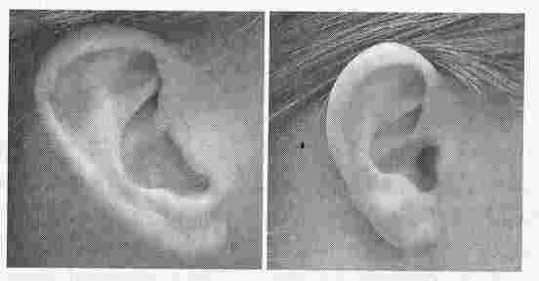
Localizing Sounds
Here are two pinnas from two different people.

Slide 19
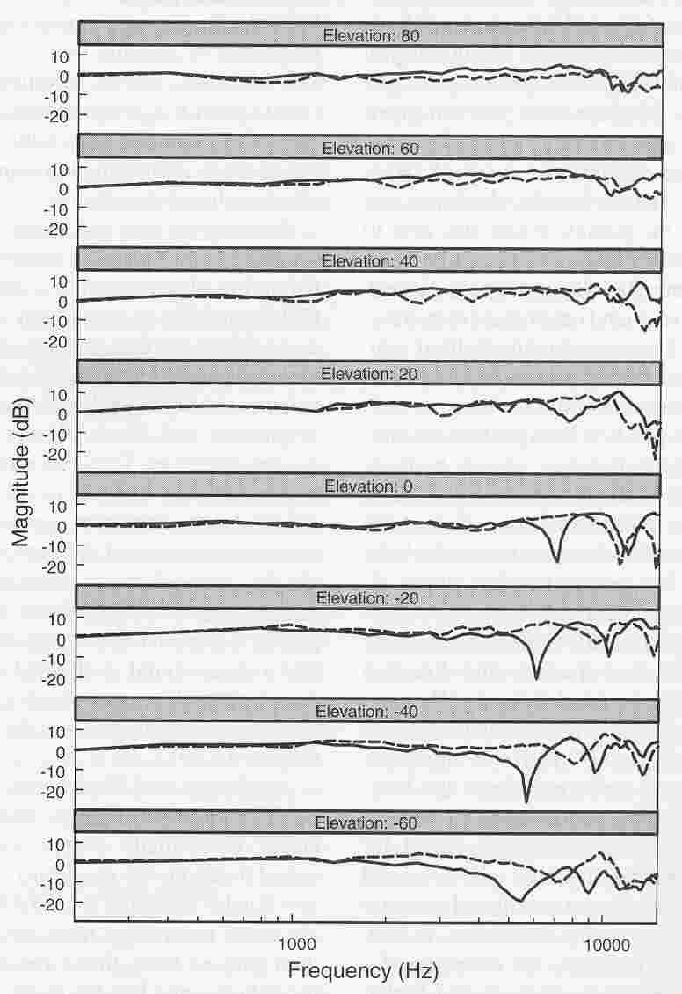
Localizing Sounds
Each unique pinna produced unique waveforms
in the auditory canal

Slide 20
Localizing Sounds
Apparently, our brains adapt to the sounds that come from our own pinnas.
Finally, it seems that monaural cues are sufficient for vertical localization (via the pinna), since people can perform vertical localization equally well in monaural and binaural conditions.

